Slide 1
University of Hassiba Benbouali-Chlef-Algeria RESEARCH METHODOLOGY « Techniques du travail universitaire 1 »
by Mr. Naimi AMARA

Slide 2
COURSE OBJECTIVES
Develop a basic understanding of research and its methodologies
Identify appropriate research topics
Select and define appropriate research problem
Prepare a project proposal
Organise and conduct research
Write a research report and thesis

Slide 3
1) SOME DEFINITIONS OF RESEARCH
SEARCH FOR KNOWLEDGE
IT IS A SYSTEMATIC AND SCIENTIFIC SEARCH FOR PERTINENT/RELEVANT INFORMATION ON A SPECIFIC TOPIC
A SYSTEMATISED EFFORT TO GAIN NEW KNOWLEDGE; A MOVEMENT FROM THE KNOWN TO THE UNKNOWN

Slide 4
DEFINITION ( cont.)
THE WORD RESEARCH IS COMPOSED OF TWO SYLLABLES, RE AND SEARCH. THE DICTIONARY DEFINES THE FORMER AS A PREFIX MEANING AGAIN, A NEW, OR OVER AGAIN AND THE LATTER AS A VERB MEANING TO EXAMINE CLOSELY AND CAREFULLY, TO TEST AND TRY, OR TO PROBE. TOGETHER THEY FORM A NOUN DESCRIBING A CAREFUL, SYSTEMATIC, PATIENT STUDY AND INVESTIGATION IN SOME FIELD OF KNOWLEDGE, UNDERTAKEN TO ESTABLISH FACTS OR PRINCIPLES.
( Grinnel 1993: 4 )

Slide 5
2) SOME TERMINOLOGIES
Methodology – refers to the methods, techniques, and procedures that are employed in implementing your research plan (design)

Slide 6
RESEARCH METHODS OR TECHNIQUES
Research methods or techniques refer to all the methods the researchers use in performing research operations ( see research instruments / research tools

Slide 7
RESEARCH METHODOLOGY
A science of studying how research is carried scientifically
A way to systematically solve the research problem by logically adopting various steps

Slide 8
3) TYPES OF RESEARCH
Research can be classified from three perspectives:
I. Application of the research study
II. Objectives
III. Inquiry mode employed

Slide 9
I. APPLICATION
If you examine a research from the perspective of its application, there are two broad categories:
A). Pure research
B). Applied research

Slide 10
A) PURE RESEARCH
According to Bailey ( 1978:17):
Pure research involves developing and testing theories and hypotheses that are intellectually challenging to the researcher but may or may not have practical application at the present time or in the future. Thus such work often involves the testing of hypotheses containing very abstract and specialised concepts.
Notes:
For example, developing a methodology to assess the validity of a procedure, or developing an instrument to measure the stress level of people

Slide 11
B) APPLIED
Most of the research undertaken in the social sciences is applied, the findings being designed either for use in understanding a phenomena/issue or to bring a change in a program/situation.

Slide 12
II. OBJECTIVES
A research study can be carried out with four objectives:
1. Descriptive
2. Correlational
3. Explanatory
4. Exploratory

Slide 13
TYPES OF RESEARCH
1. Descriptive:
The main purpose of such studies is to describe what is prevalent with respect to the issue/ problem under study. The main characteristic of descriptive research is that the researcher has no control over the variables; he can only report what has happened or what is happening.
The term Ex post facto ( after the fact ) research for descriptive research is used mainly in social science and business research
Notes:
descriptive research is description of the state of affairs as it exist at present

Slide 14
DESCRIPTIVE RESEARCH
Some examples:
Attitudes of students towards quality
teaching
Strategies put in place by a company to increase workers’ productivity
Effects of living in a house with domestic violence

Slide 15
TYPES OF RESEARCH ( cont.)
2. Correlational
Aims at discovering or establishing the existence of a relationship/ association/ interdependence between two or more aspects of a situation
For instance, the effect of the home environment on education

Slide 16
CORRELATIONAL RESEARCH
Some examples
Relationship between stressful living and incidence of heart attacks
Impact of technology on the language classroom
Impact of domestic violence on adolescents

Slide 17
TYPES OF RESEARCH
3. Explanatory:
Attempts to clarify why and how there is a relationship between two aspects of a situation or phenomenon. This type of research will try to explain, for example, how the home environment affects children level of academic achievement.

Slide 18
EXPLANATORY RESEARCH
Some examples:
How does domestic violence impact adolescents learners ?
Why do some schools adopt a program while others do not?
How does technology facilitate learning?

Slide 19
TYPES OF RESEARCH
4. Exploratory:
This is when a study is undertaken with the objective either to explore an area where little is known or to investigate the possibilities of undertaking a particular research study. When a study is carried out to determine its feasibility it is also called a feasibility study or a pilot study

Slide 20
3. INQUIRY MODE
From the point of view of inquiry , there are two types of research:
1. The structured approach
2. The unstructured approach

Slide 21
1.THE STRUCTURED APPROACH
This is usually classified as quantitative research
quantitative studies often use standardized measures, numerical values, have larger sample sizes, and analyze data using statistical programs. A study is classified as quantitative if the researcher seeks to quantify the variation in a phenomenon and if information is gathered using quantitative variables.

Slide 22
2. THE UNSTRUCTURED APPROACH
The unstructured approach to inquiry is usually classified as qualitative
A study is classified as qualitative if the purpose is primarily to describe a situation, phenomenon, problem or event; the information is gathered through the use of variables or measured on qualitative measurement scales, and if analysis is done to establish the variation in the situation or problem without quantifying it. Qualitative studies tend to be more “in-depth”, focusing on a smaller population but probing deeper into a given problem.

Slide 23
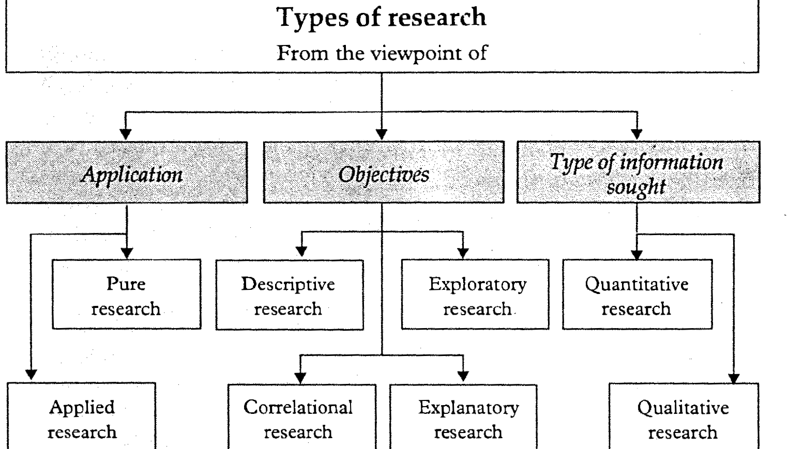

Slide 24
4.QUALITIES OF A GOOD RESEARCH
Research must address an important and relevant issue.This means that:
-it is undertaken to increase knowledge and have some beneficial implications
-it will also have relevance to the time, place, and population of the study.

Slide 25
QUALITIES OF A GOOD RESEARCH
Research is a process of collecting, analyzing and interpreting information to answer questions. But to qualify as research, the process must have certain characteristics: it must, as far as possible, be:
Logical
Rigorous
Systematic
Valid and verifiable
Empirical
Critical

Slide 26
QUALITIES OF GOOD RESEARCH ( cont.)
Good research is logical: this implies that research is guided by the rules of logical reasoning ,and the logical process of induction and deduction is essential in carrying out research.

Slide 27
QUALITIES OF GOOD RESEARCH ( cont.)
Rigorous-you must be scrupulous (careful) in ensuring that the procedures followed to find answers to questions are relevant, appropriate and justified. Again, the degree of rigor (strict) varies markedly between the physical and social sciences and within the social sciences.

Slide 28
QUALITIES OF GOOD RESEARCH ( cont.)
Good research is systematic: this implies that the procedure adopted to undertake an investigation follow a certain logical sequence. The different steps cannot be taken in a haphazard way. Some procedures must follow others. The systematic characteristic of research rejects the use of guessing and intuition in arriving at conclusions.

Slide 29
SYSTEMATICNESS
Good research is systematic as it follows certain steps. These steps are:
Problem identification
Reviewing the literature
Collecting data
Analysing data
Drawing conclusions and making generalisations

Slide 30
QUALITIES OF GOOD RESEARCH ( cont.)
-Valid and verifiable-this concept implies that whatever you conclude on the basis of your findings is correct and can be verified by you and others.
-Empirical-this means that any conclusion drawn are based upon hard evidence gathered from information collected from real life experiences or observations.

Slide 31
QUALITIES OF GOOD RESEARCH(cont.)
Critical-critical scrutiny ( examination) of the procedures used and the methods employed is crucial to a research enquiry. The process of investigation must be foolproof and free from drawbacks. The process adopted and the procedures used must be able to withstand critical scrutiny.

Slide 32
5)THE RESEARCH PROCESS: AN EIGHT – STEP MODEL
A) 5 STEPS IN PLANNING A RESEARCH STUDY
Step 1: Formulating a research problem
Step 2: Conceptualising a research design
Step 3: Constructing an instrument for data collection
Step 4: Selecting a sample
Step 5: Writing a research proposal

Slide 33
THE RESEARCH PROCESS:
B) 3 STEPS IN CONDUCTING A STUDY
Step 6: Collecting data
Step 7: Processing data
Step 8: Writing a research report

Slide 34

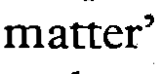
222222333

Slide 35

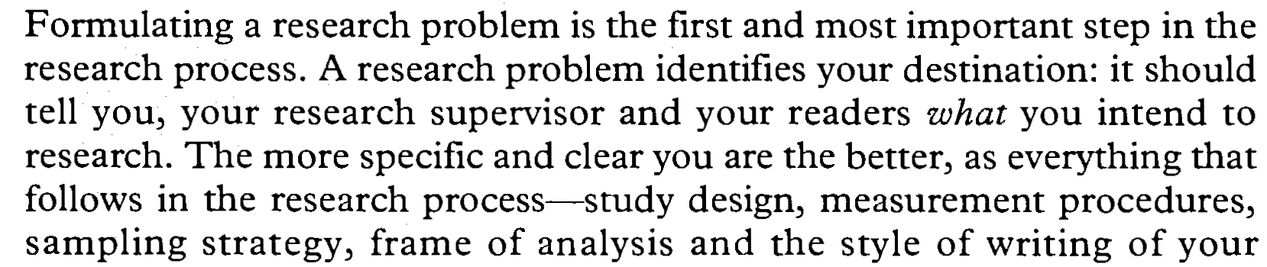

Slide 36
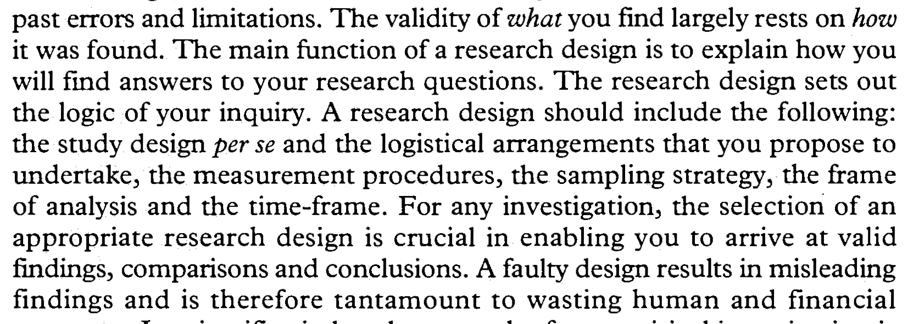


Slide 37
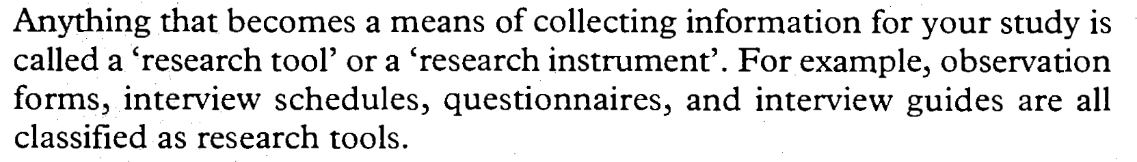




Slide 38

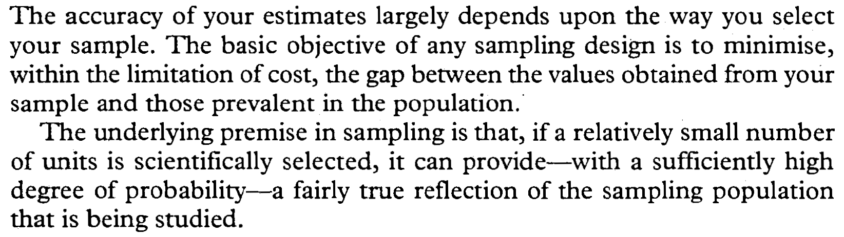

Slide 39

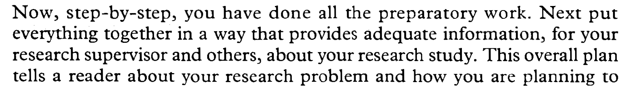
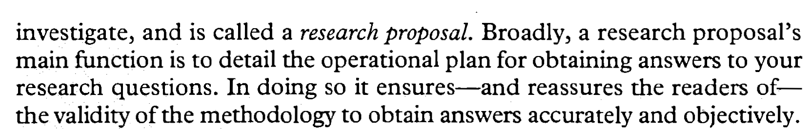

Slide 40

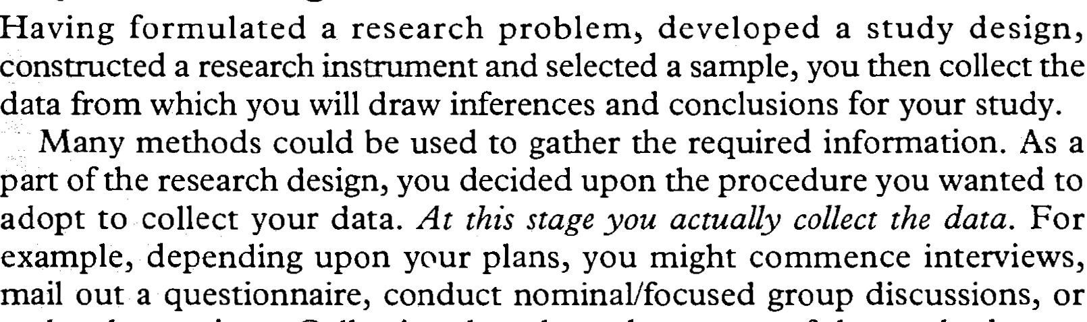


Slide 41

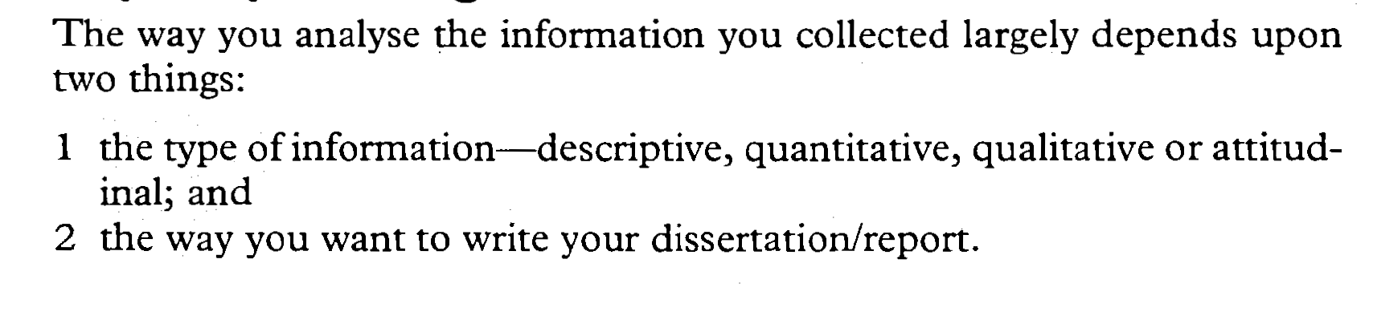
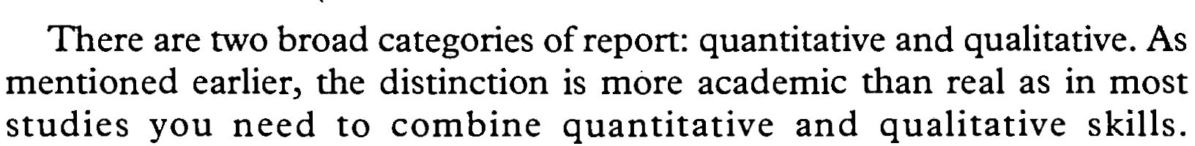

Slide 42
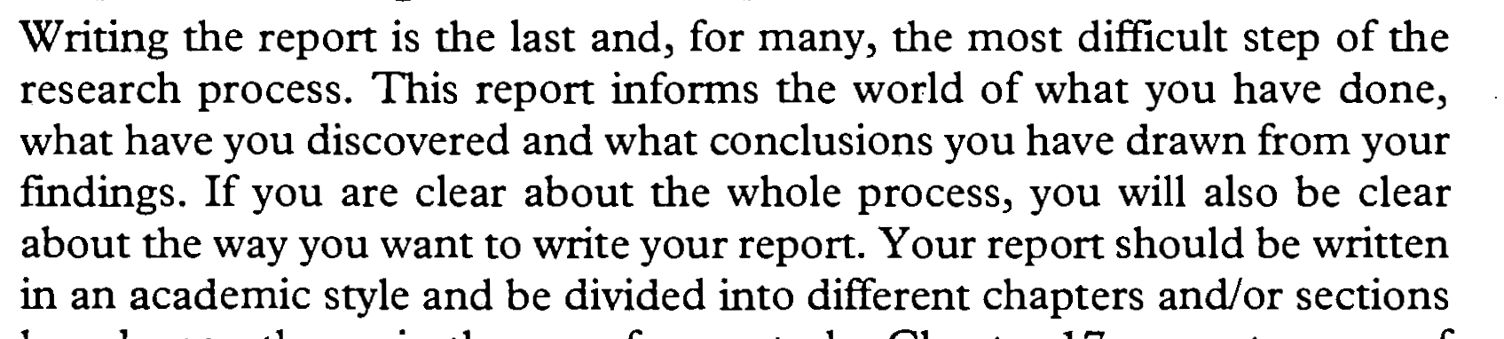

Slide 43
6. HOW TO SELECT A RESEARCH PROBLEM
An ‘angle’ for your research can come from insights stemming from:
personal experience
theory
observations
contemporary issues
engagement with the literature

Slide 44
What is a research problem?!
A research problem, in general, refers to some difficulty which a researcher experiences in the context of either a theoretical or practical situation and wants to obtain a solution for the same. The research problem undertaken for study must be carefully selected. The task is a difficult one, although it may not appear to be so. Help may be taken from a research guide in this connection. Nevertheless, every researcher must find out his own salvation for research problems cannot be
borrowed.

Slide 45
Why are research questions important?
“Well-crafted questions guide the systematic planning of research. Formulating your questions precisely enables you to design a study with a good chance of answering them.”
-- Light, Singer, Willett, By Design (1990)

Slide 46
STATEMENT OF PROBLEM
After selecting a problem, it should be stated carefully by the researcher to delimit his task and isolate a specific problem before he can proceed with active planning of the study. This type of decision is culminated in the problem statement.
Kerlinger (1964) has identified three criteria of good Problem Statements.
1. A problem should be concerned with relation between two or more variables. (eg, age, sex . . . .etc)
2. It should be stated “clearly and unambiguously in question form.
3. It should be amenable to empirical testing.
Notes:
.

Slide 47
7. Considerations in selecting a good research problem
1.Interest: a research endeavour (attempt) is usually time consuming, and involves hard work and possibly unforeseen problems. One should select topic of great interest to sustain the required motivation.
2. Magnitude(manageability): It is extremely important to select a topic that you can manage within the time and resources at your disposal. Narrow the topic down to something manageable, specific and clear.

Slide 48
3.Measurement of concepts: Make sure that you are clear about the indicators and measurement of concepts (if used) in your study. Do not use in your research problem concepts that you are not sure how to measure.
4. Level of expertise: Make sure that you have adequate level of expertise (know how / knowledge) for the task you are proposing since you need to do the work yourself.

Slide 49
5.Relevance: Ensure that your study adds to the existing body of knowledge, bridges current gaps and is useful in policy formulation. This will help you to sustain interest in the study.
6. Availability of data: Before finalizing the topic, make sure that data are available.
7. Ethical issues: How ethical issues can affect the study population and how ethical problems can be overcome should be thoroughly examined at the problem formulating stage.

Slide 50
8.The Foundation of Hypotheses
The second step in the research process of social study is to formulate hypotheses. The hypothesis is a tentative solution of a problem. The research activities are planned to verify the hypothesis and not to find out the solution of the problem or to seek an answer of a question. It is very essential to a research worker to understand the meaning and nature of hypothesis. The researcher always plan or formulate a hypothesis in the beginning of the problem.

Slide 51
MEANING OF HYPOTHESIS
The word hypothesis is made up of two Greek roots : Hypo + thesis = Hypothesis
‘Hypo’ means tentative or subject to the verification and ‘Thesis’ means statement about solution of a problem.
The world meaning of the term hypothesis is a tentative statement about the solution of the problem. Hypothesis offers a solution of the problem that is to be verified empirically and based on some rationale.

Slide 52
Hypotheses are designed to express relationships between variables. If this is the nature of your question, a hypothesis can add to your research
If your question is more descriptive or explorative, generating a hypothesis may not be appropriate

Slide 53
9.The formulation of objectives:
Objectives are the goals you set out to attain in your study.
-They inform a reader what you want to attain through the study.
-It is extremely important to word them clearly and specifically.
Objectives should be listed under two headings:
a) main objectives ( aims);
b) sub-objectives.

Slide 54
The main objective is an overall statement of the thrust of your study.
It is also a statement of the main associations and relationships that you seek to discover or establish.
The sub-objectives are the specific aspects of the topic that you want to investigate within the main framework of your study.

Slide 55
The research objectives
-They should be numerically listed.
-Wording should clearly, completely and specifically communicate to your readers your intention.
-Each objective should contain only one aspect of the Study.
-Use action oriented words or verbs when writing objectives.

Slide 56
The objectives should start with words such as:
‘to determine’, ‘to find out’,‘to ascertain’,
‘to measure’,‘to explore’ etc.
The wording of objectives determines the type of research (descriptive, correlational
and experimental) and the type of research design you need to adopt to achieve them.

Slide 57
Examples
Descriptive studies:
-To describe the types of incentives provides by Hotel XYZ to employees in Algeria.
-To find out the opinion of the employees about the medical facilities provided by five star hotels in Algeria.
Correlatinal studies:
-To ascertain the impact of training on employee retention.
-To compare the effectivenesss of different loyalty programmes on repeat clientele.

Slide 58
Hypothesis –testing studies:
-To ascertain if an increase in working hours will increase the incidence of drug/alchohol abuse.
-To demonstrate that the provision of company accommodation to employees in Algiers hotels will reduce staff turnover.

Slide 59
10.WHAT IS A LITERATURE REVIEW?
The phrase ‘review of literature’ consists of two words: Review and Literature.
The word ‘literature’ in research methodology refers to the knowledge of a particular area of investigation of any discipline which includes theoretical, practical and its research studies.
The term ‘review’ means to organize the knowledge of the specific area of research to evolve an edifice of knowledge to show that his study would be an addition to this field.

Slide 60
Review of literature
The term ‘review of literature’ has been defined in the following ways:
According to W.R. Borg
“The literature in any field forms the foundation upon which all future work will be built. If we fail to build the foundation of knowledge provided by the review of literature our work is likely to be shallow and naive and will often duplicate work that has already been done better by some one else.”

Slide 61
Some definitions of L.R:
According to John W. Best
“Practically all human knowledge can be found in books and libraries. Unlike other animals that must start a new with each generation, man builds upon the accumulated and recorded knowledge of the past. His constant adding to the vast store of knowledge makes possible progress in all areas of human endeavour.”

Slide 62
FUNCTIONS OF THE LITERATURE REVIEW
a. Bring clarity and focus to your research problem;
b. Improve your methodology;
c. Broaden your knowledge;
d. Contextualise your findings.
.

Slide 63
a. Bring clarity and focus to your research problem;
The process of reviewing the literature helps you to understand the subject area better and thus helps you to conceptualise your research problem clearly and precisely. It also helps you to understand the relationship between your research problem and the body of knowledge in the area.

Slide 64
b. Improve your methodology:
A literature review tells you if others have used procedures and methods similar to the ones that you are proposing, which procedures and methods have worked well for them, and what problems they have faced with them. Thus you will be better positioned to select a methodology that is capable of providing valid answer to your research questions.

Slide 65
. c. Broaden your knowledge base in your research area:
It ensures you to read widely around the subject area in which you intend to conduct your research study. As you are expected to be an expert in your area of study, it helps fulfill this expectation. It also helps you to understand how the findings of your study fit into the existing body of knowledge.

Slide 66
d. Contextualise your findings:
How do answers to your research questions compare with what others have found? What contribution have you been able to make in to the existing body of knowledge? How are your findings different from those of others? For you to be able to answer these questions, you need to go back to your literature review. It is important to place your findings in the context of what is already known in your field of enquiry.

Slide 67
STEPS IN CONDUCTIONG A LITERATURE REVIEW
Search for existing literature in your area of study
Review the literature selected
Develop a theoretical framework
Develop a conceptual framework
Write your literature review

Slide 68
REVIEWING THE LITERATURE
Read critically the contents of books and articles and look for the following things:
The claims and theories put forward.
The criticisms of these and their basis.
The methodologies adopted, and the criticisms about them.
The conclusions and findings advanced
Disagreements about the constructs you are investigating
The gaps you notice in the literature

Slide 69
DEVELOPING A THEORETICAL FRAMEWORK
The information obtained from books and journals now needs to be sorted under main themes and theories, agreements and disagreements among authors, and other aspects related to your research topic; all this needs to be arranged so as each element will fit in a slot of the theoretical framework

Slide 70
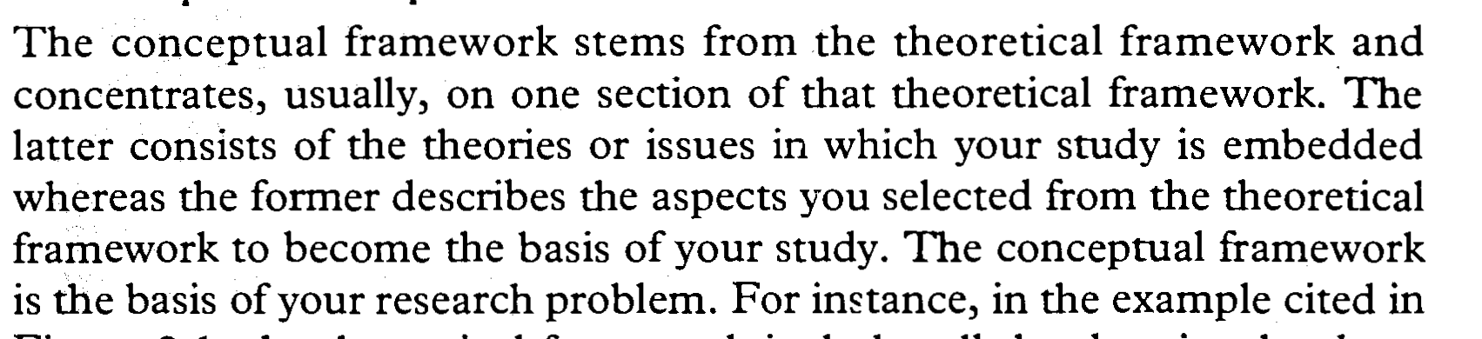
DEVELOPING A CONCEPTUAL FRAMEWORK

Slide 71
Writing Lit. Review – Logical Argument / A Critique
A was the earliest writers to discuss . . .
B made a valuable contribution to the discussion of this problem . . .
C argued that D had not used the appropriate methods . . .
In the 1990s E proposed a completely different approach. . .
The best study of this problem is perhaps by F . . .

Slide 72
WHERE TO FIND SOURCES FOR THE LITERATURE REVIEW
BOOKS
INTERNET
JOURNALS
ARCHIVES
REPORTS
OBSERVATIONS
RECORDS…

Slide 73
PROBLEMS IDENTIFIED IN WRITING A LITERATURE REVIEW
Some reviews consist of a largely unrelated annoted list of studies.
Some reviews are not relevant to the investigation
Theories in the review might be mentionned or described, but often without a clear, logical connection among the theories, or without showing the relevance of each description

Slide 74
ANSWERING SOME OF THE PROBLEMS RELATED TO THE L.R.
The literature you decide to include must be relevant to the area of your investigation
The pieces of literature you decide to include must be logically connected to each other

Slide 75
BOOKS
Use books first as they gather a lot of information on a topic
They also provide a good background information on a topic
They also offer intersting extensive bibliographies

Slide 76
JOURNAL ARTICLES
Look for journal articles second
They discuss one pespective
Each article makes a unique contribution
They can supplement information from books
They offer more up-to- date information

Slide 77
11. WHAT ARE DATA ?
The term data refers to any kind of information researchers obtain on the subjects, respondents, or participants of the study. In research, data are collected and used to answer the research questions and objectives of the study

Slide 78
Data collection is an extremely important part of any research because the conclusion of a study is based on what the data reveal. The choice of procedures usually depends on the objectives and design of the study

Slide 79
10.TYPES OF RESEARCH DATA
Research data are generally classified either as quantitative or qualitative. Based on their sources, they fall under two categories:
Primary data;
Secondary data

Slide 80
QUANTITATIVE AND QUALITATIVE DATA
Quantitative data:
These are information which can be counted or expressed in numerical values
e.g. nb of students, age, grades, test scores…
Qualitative data:
These are descriptive information which has no numerical values.
e.g. A person’s attitude, perception, or feelings

Slide 81
TYPES OF DATA:
Primary data;
Secondary data

Slide 82
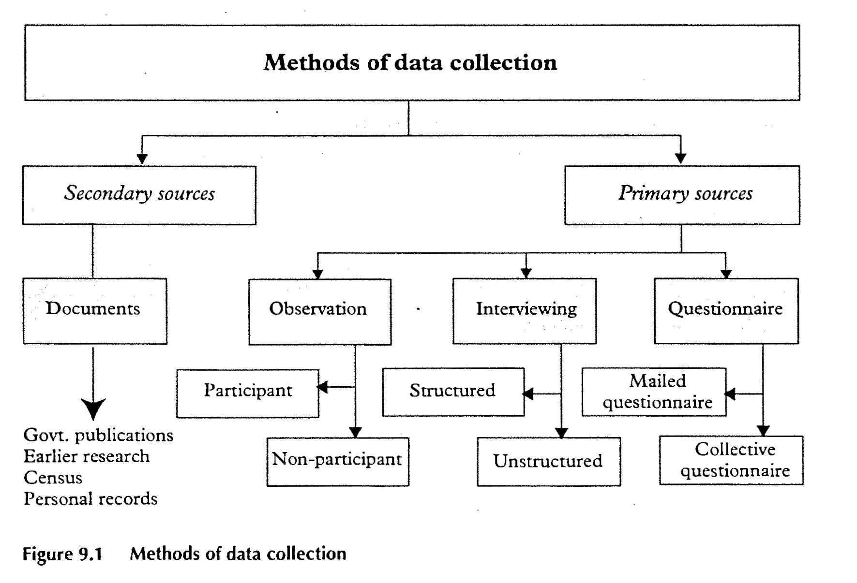
Methods of Data Collection

Slide 83
PRIMARY VS SECONDARY DATA
Primary data are originated by a researcher for the specific purpose of addressing the problem at hand. They are collected directly from the subjects being studied.

Slide 84
PRIMARY VS SECONDARY DATA
Secondary data:
These are information already available. They have been collected from other available sources ( recent censuses and analysed by someone else for purposes other than the problem at hand. Secondary data may be published or unpublished.

Slide 85
11. COLLECTING DATA USING PRIMARY SOURCES
Research tools:
1. Questionnaires
2. Interview schedules
3. Observations

Slide 86
1. The questionnaire
HOW TO CONSTRUCT A QUESTIONNAIRE
Questionnaires must contain simple but straightforward directions for the respondents so that they may not feel any difficulty in answering the question.
Do not use ambiguous questions or questions based on presumptions (supposition or guessing; : questions should be kept short and clear, free from guessing and interpretations.

Slide 87
HOW TO CONSTRUCT A QUESTIONNAIRE
Do not ask leading questions): Don’t lead the respondents to answer in a certain way.
Eg: How often do you wash your car?
Assumes that the respondent has a car and he washes it. Instead, ask a filter question to find if he has a car or not and then : " if you wash your car, how many times a year?"

Slide 88
Double-barrelled questions should be avoided.i.e. two questions in one / asking two qustions rather than one.

Slide 89
Types of questionnaire:
There are three basic types of questionnaire, they are classified according to the kind of questions they include:
1. Closed-ended
2. Open- ended
3. Combination of both

Slide 90
TYPES OF QUESTIONS IN A QUESTIONNAIRE
1. Closed format questions ( closed-ended)
closed- ended questions include all possible answers/ prewritten response categories, and respondents are asked to choose among them.
e.g. An example of a closed form questionnaire item follows:
If group tests are used in your school, by whom are they administered?
(a) Administrators (b) Consellors,
(c) Psychologists, (d) Psychometricians,
(e) Teachers, and (f) Others

Slide 91
TYPES OF QUESTIONS IN A QUESTIONNAIRE
2. Open format questions: (open-ended)
Open- ended questions allow respondents to answer in their own words.
It doesn’t contain boxes to tick but instead it leaves a blank for the respondent to write in an answer.
e.g. state your opinion about the quality of X products and services
---------------------------------------------------------
---------------------------------------------------------

Slide 92
TYPES OF QUESTIONS IN A QUESTIONNAIRE
3. Combination of both: this way, it is possible to find out how many people use a service and what they think of the service in the same form.
Begin with a series of closed-ended questions, with boxex to tick or scales to rank, and they finish with a section of open-ended questions or more detailed response.

Slide 93
Other types of questions :
4. Dichotomous questions:
e.g. Do you like the products of X company?
yes no
5. Importance questions:
e.g. Cost effective services are:
a. extremely important b. very important.
c. somewhat important d. not very important

Slide 94
6. Likert questions:
e.g. X Corporation products have to improve on quality.
1. agree
2. strongly agree
3. neither agree nor disagree (undecided)
4. disagree
5. strongly disagree

Slide 95
7. Bipolar questions:
e.g. How would you describe the services of X corporation?
efficient ---- -X--- ---- ---- ---- ---- ---- inefficient
fast ---- ----- ---- ---X-- ---- ---- slow
reliable ---- ---- --X-- ---- ---- ---- unreliable

Slide 96
8. rating scales:
e.g. How would you rate the services of X corporation?
1. good 2. fair 3. poor 4. very poor

Slide 97
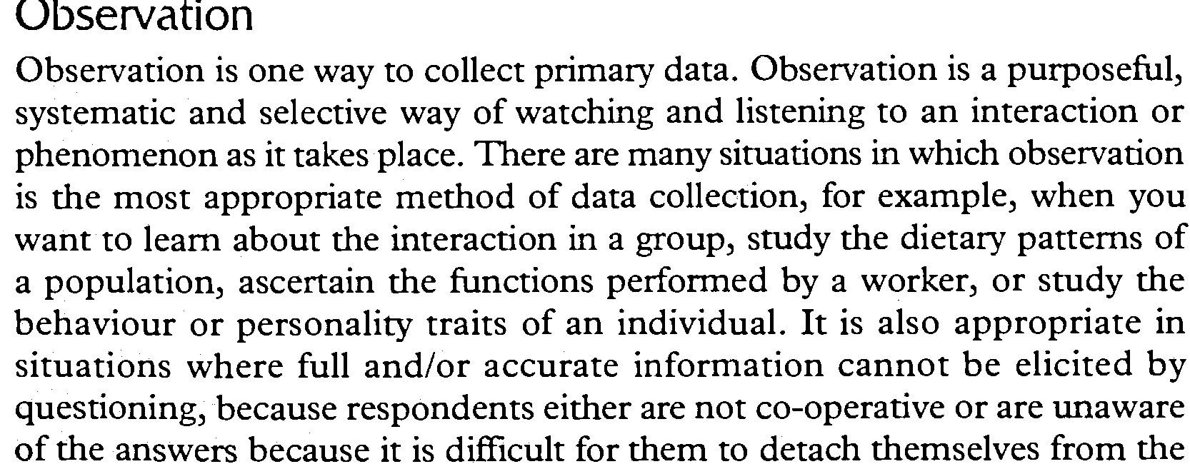
3.Observation

Slide 98


Slide 99
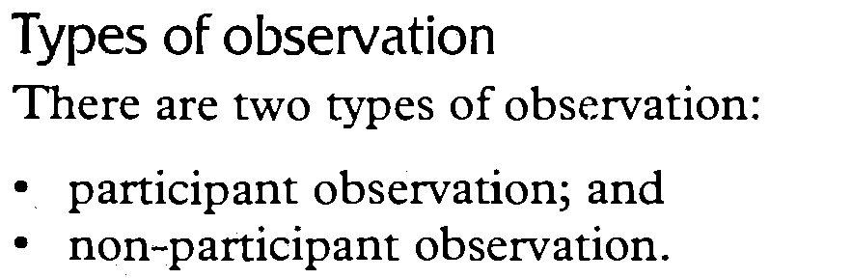

Slide 100
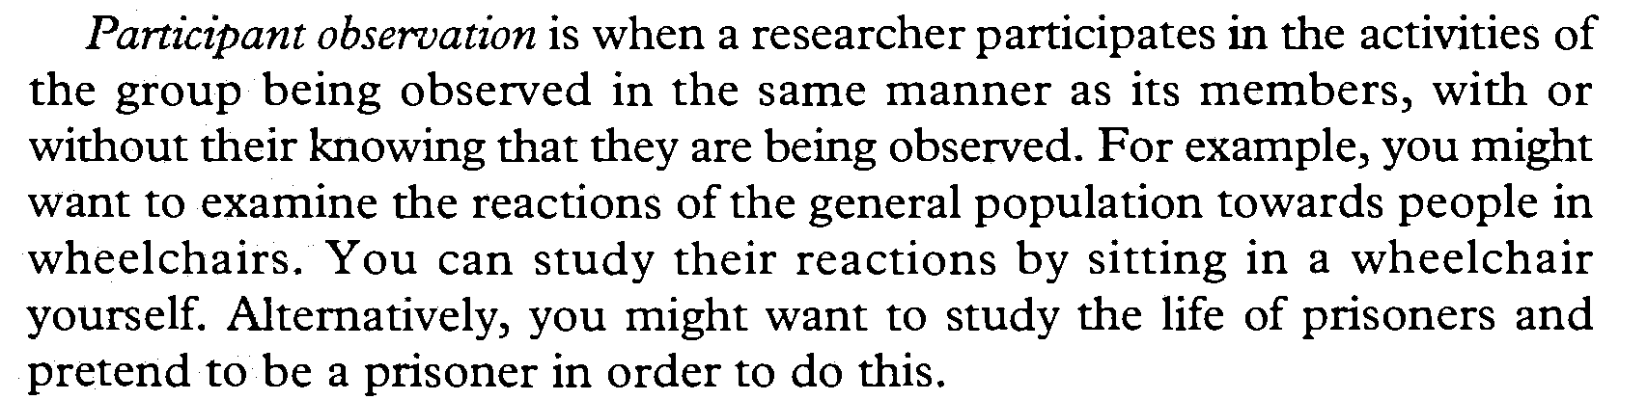

Slide 101
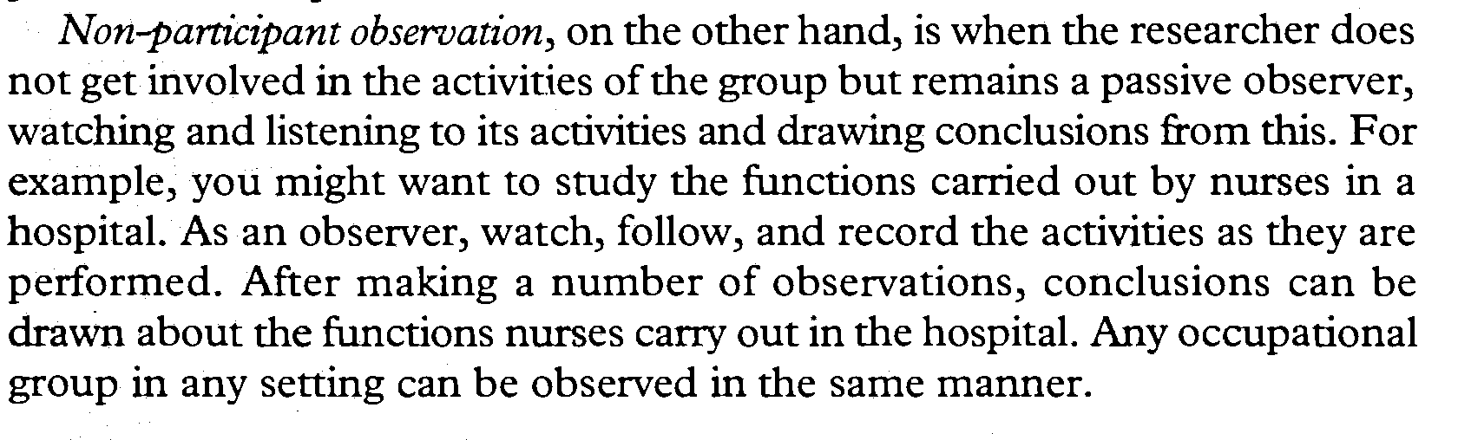

Slide 102
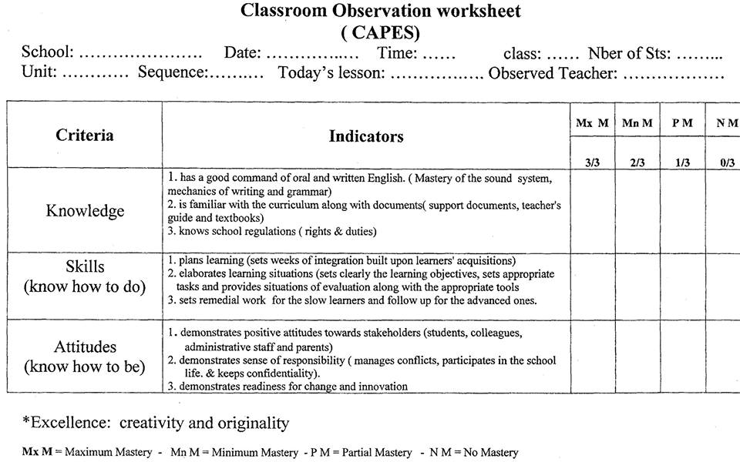
An example of an observation workshet

Slide 103
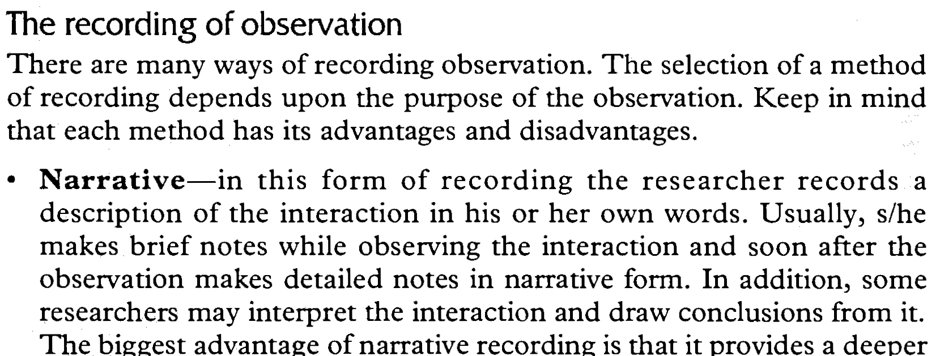


Slide 104
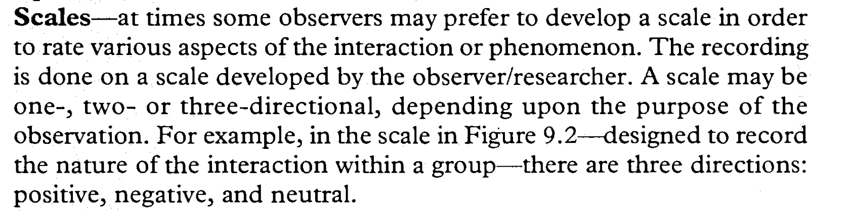

Slide 105
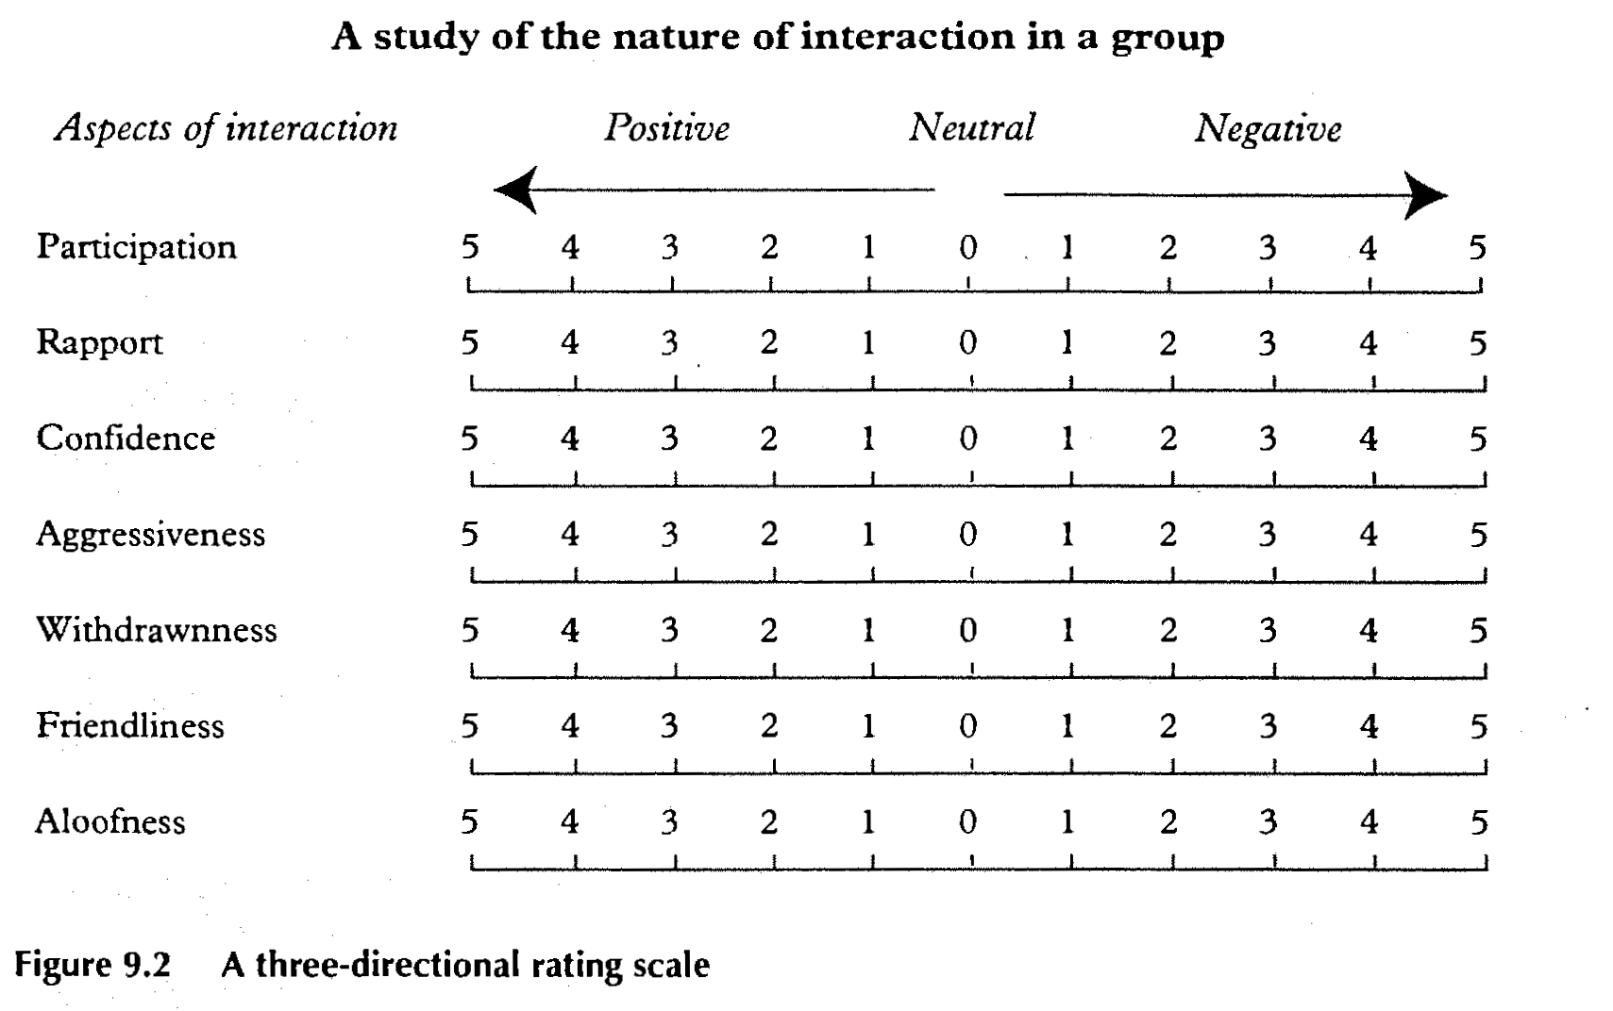

Slide 106
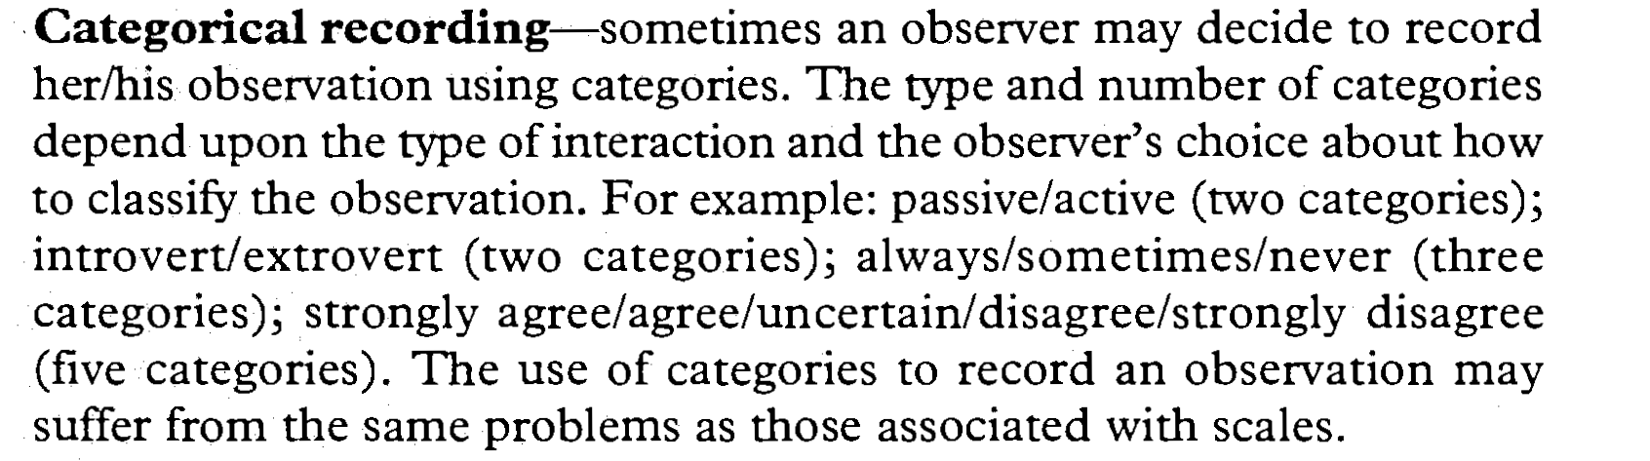

Slide 107
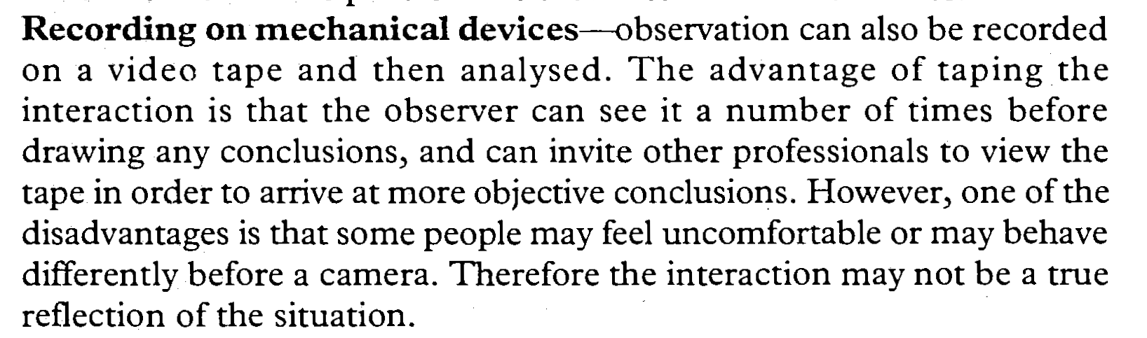

Slide 108
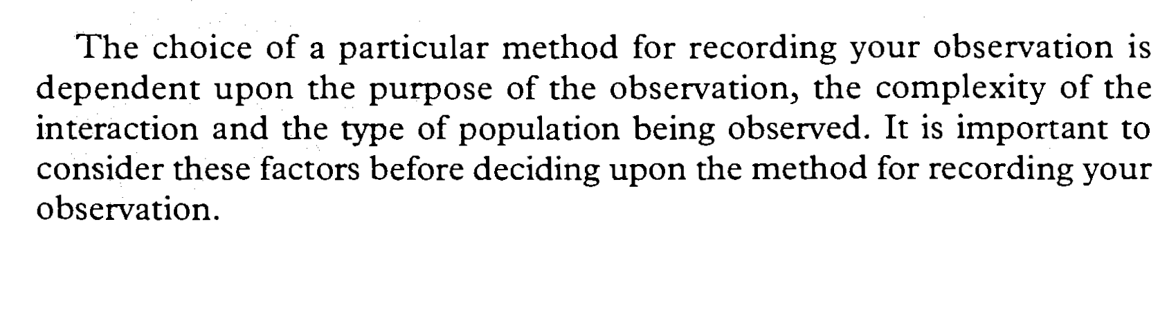

Slide 109
2. Interview
2.1. What is an interview ?
a) A structured set of questions designed to obtain information from a sample.
b) Oxford Dictionary definition : a meeting at which a journalist / interviewer asks somebody questions to find out his/her opinion ,etc ( often shown on television or printed in newspaper ).

Slide 110
2.2.Why is it important ?
It is very useful for getting the story behind a participant's experience. The interviewer can follow in-depth information around a topic. Interviews usually follow up certain respondents’ questionnaires to further investigate their responses. Usually open-ended questions are asked during interviews.

Slide 111
2.3.Some Guidelines for Conducting Interviews
Before starting to design the interview questions and process, the researcher should clearly articulate to himself what problem or need is to be addressed using the information to be gathered by the interviews. This helps him to keep clear focus on the aim of each question.

Slide 112
2.4. Preparation for Interview
1.Choose a setting with little distraction. Avoid loud lights or noises, ensure the interviewee is comfortable. (Often, interviewees may feel more comfortable at their own places of work or homes.)
2. Explain the purpose of the interview.
3. Address terms of confidentiality. Note any terms of confidentiality. Explain who will get access to their answers and how they will be analyzed. If their comments are to be used as quotes, get their written permission to do so.
.

Slide 113
4. Explain the format of the interview. Explain the type of interview you are conducting and its nature
5. Indicate how long the interview usually takes.
6.Tell them how to get in touch with you later if they want to.
7. Ask them if they have any questions before you both get started with the interview.
8. Don't count on your memory to recall their answers. Ask for permission to record the interview or bring along someone to take notes.

Slide 114
2.5. Types of Topics in Questions
A specialist in the field called Patton notes six kinds of questions. One can ask questions about:
a-Behaviours - about what a person has done or is doing
b. Opinions/values - about what a person thinks about a topic
c. Feelings - note that respondents sometimes respond with "I think ..." so be careful to note that you're looking for feelings.
d. Knowledge - to get facts about a topic
e. Sensory - about what people have seen, touched, heard, tasted or smelled
f. Background/demographics - standard background questions, such as age, education, etc.

Slide 115
2.6. Wording of Questions
Wording should be open-ended. Respondents should be able to choose their own terms when answering questions.
Questions should be as neutral as possible. Avoid wording that might influence answers, e.g., evocative, judgmental wording.
Questions should be asked one at a time.
Questions should be worded clearly. This includes knowing any terms particular to the program or the respondents' culture.
Be careful asking "why" questions. This type of question infers a cause-effect relationship that may not truly exist. These questions may also cause respondents to feel defensive, e.g., that they have to justify their response, which may inhibit their responses to this and future questions.

Slide 116
2.7. Conducting Interviews
1.Occasionally verify the tape recorder (if used) when working.
2.Ask one question at a time.
3.Attempt to remain as neutral as possible. That is, don't show strong emotional reactions to their responses. Patton suggests to act as if "you've heard it all before."
4.Encourage responses with occasional nods of the head, "uh huh"s, etc.

Slide 117
5.Be careful about the appearance when note taking. That is, if you jump to take a note, it may appear as if you're surprised or very pleased about an answer, which may influence answers to future questions.
6.Provide transition between major topics, e.g., "we've been talking about (some topic) and now I'd like to move on to (another topic)."
7.Don't lose control of the interview. This can occur when respondents talk about a different topic, take a long time to answer and time is running out , or even begin asking questions to the interviewer.

Slide 118
COMPREHENSION QUESTIONS
• What question is addressed by this research? Explain the relevant past research and the ideas that led to this question.
• What hypothesis was investigated in this study? Explain how it is related to the research question you discussed in #1 above.
• How was the study set up? Explain why it was set up this way.
• What data were collected? Explain why the authors chose these particular data to collect.
• What were the results?
• Explain how well the results do (or do not) support the hypothesis.
• Explain any alternative explanations for the findings (your own ideas and/or the authors’).
• What further research does this study suggest (to you and/or the author)? Explain why it should be conducted.

Slide 119
HOW TO READ A RESEARCH PAPER: A FOUR- STEP GUIDE
the four steps: Skimming, vocabulary, comprehension, and analysis.
1. Skimming. Skim the paper quickly, noting basics like headings, figures and the like.
2. Vocabulary. Go through the paper word by word and line by line, underlining or highlighting every word and phrase you don't understand.

Slide 120
HOW TO READ A RESEARCH PAPER: A FOUR- STEP GUIDE
3. Comprehension, section by section. Try to deal with all the words and phrases, although a few technical terms in the Methods section might remain. Now go back and read the whole paper, section by section, for comprehension.
Here are some qqs. that you might use to help you better understand the article.

Slide 121
HOW TO READ A RESEARCH PAPER: A FOUR- STEP GUIDE
4. Analysis. After you understand the article and can summarize it, then you can return to broader questions and draw your own conclusions.

Slide 122
ANALYSING RESEARCH PAPERS
Here are some questions that may be useful in analysing research papers:
Introduction:
• What is the overall purpose of the research?
• How does the research fit into the context of its field? Is it, for example, attempting to show the effectiveness of a program? show the validity of a new technique? open up a new field of inquiry?
• Do you agree with the author's rationale for studying the question with this particular methodology?

Slide 123
ANALYSING RESEARCH PAPERS (QQS.)
Methods:
• Were the measurements appropriate for the questions the researcher was approaching?
• How is the study controlled? are there control groups? If so, are they exactly comparable to the experimental groups?
• Were the measures in this research clearly related to the variables in which the researchers (or you) were interested?
• If human subjects were studied, did they accurately represent the populations under study?

Slide 124
ANALYSING RESEARCH PAPERS ( QQS.)
Results
• What is the one major finding?
• Were enough of the data presented so that you feel you can judge for yourself how the experiment turned out?
• Did you see patterns or trends in the data that the author did not mention? Were there problems in data interpretation that were not addressed

Slide 125
ANALYSING RESEARCH PAPERS (QQS.)
Discussion
• Do you agree with the conclusions drawn from the data?
• Are these conclusions over-generalized or appropriately careful?
• Are there alternative interpretations of the data?
• What further experiments can you think of, to continue the research or to answer remaining questions ?

Slide 126
CONCEPTUALING A RESEARCH DESIGN
A research design is a procedural plan that is adopted by the researcher to answer questions validly, objectively, accurately and economically

Slide 127
References (Bibliography): How to cite the references
You need to be aware that there are different conventions for listing different types of sources, such as books, journals, conference proceedings, and websites. The format for referencing each of these sources is given below. In the demonstrations below, the generic format for the specific type of source is first given, followed by examples. Note that for book referencing, the title of the book is italicized, whereas for a journal it is the name of the journal that is in italics. Note below that the convention is to insert a full stop (.) after the author’s name and year (e.g. ‘Dreyfuss, H. L. (2001).’); however some publishers omit this convention, preferring to implement their own house style.

Slide 128
Rules to follow:
There are two rules to follow in the References section:
First, you should list only significant, published references. References to unpublished data, abstracts, theses, and other secondary materials should not clutter up the References or Literature Cited section. If this reference seems to be essntial, you may add it parenthetically or as a foortnote in the etxt.
Second, make sure that all references cited in the text are indeed listed in the bibliography and that all the references listed under the bibiography are indeed cited somewhere in the text.

Slide 129
Most journals cite references in one of the of the three general ways that may be referred to as :
Author and Year Sytem: often referred to as the Harvard system. It has been very popular for many years and is used in many journals and books.
Inside the text, you state only the AUTHORr+ YEAR either with a quotation or without. Full details of the source are given in a reference list ( bibliography) at the end of the text. This allows the writer to acknowledge his/her sources without significantly interrupting the flow of the writing.

Slide 130
You should always include the page number when you include a passage of direct quoatation from another writer’s work.
Eg. -The seminars……………………employees.(Lyon,1992)
-Kneeper and Cropley (1991:p.44) believe that………..
When a publication has several authors (more than two), it is advisable to give the surname of the first author followed by et al
( an abbreviation of the Latin for « and the others ».)
Eg: Cohen et al. (2000). Research Methods in Education. 5th edition London: Routledge Falmer.
This is used only inside the paper. In the bibliography section, the names of the authors should be all mentioned.

Slide 131
2. Alphabet-Number System: Citation by numbers is a modification of the name and year system. Citation by numbers keeps printing expenses within bounds particularly if it is a long list.Some authors who have habitually used name and year tend to dislike the alphabet-number system, claiming that citation of numbers cheat the reader. The reader should be told, so the argument goes, the name of the person associated with the cited phenomenon; sometimes, the readershould also be told the date, on the grounds that an 1897 reference might be viewed differently than a 1997 reference.
Fortunately, these arguments can be overcome. As you cite references in the text, decide whether names and dates are imortant. I f they are not, use only the reference number:

Slide 132
Eg: "Peretyrosine is quantitatively converted to phenylalanine under these conditions (13)." If you want to feature the name of the author, do it within the context of the sentence:
"The role of the carotid sinus in the regulation of respiration was discovered by Heymans (13)." If you want to feature th date, you can also do that within the sentence: " Streptomycin was first used in the treatment of tuberculosis in 1945 (13)."

Slide 133
3. Citation Order System: It is simply a system of citing the references (by numbers) in the order they appear in the paper. This system avoids the substantial printing expense of the name and year system, and readers often like it because they can quickly refer to the references if they so desire in one-two-three order as they come to them in the text. It is a useful system for a journal that is basically a " note " journal, each paper contatining only a few references. For long papers, with many references, citation order is probably not a good system.

Slide 134
Examples of diffrerent reference styles:
1.Author and Year Sytem:
Day, R.A.1998. How to write and publish a scientific paper. 5th ed. Phoenix: Oryx Press.
Hutch, E.J.1986. Guidelines on authorship of medical papers. Ann. Interm. Med. 104: 269-274.
Sproul,J.,H.Klaaren, and F.Mannarino. 1993. Surgical treatment of Freiberg’s infraction in athletes. Am. J. Sports Med. 21:381-384.

Slide 135
2. Alphabet-Number System:
1. Day, R.A.1998. How to write and publish a scientific paper. 5th ed. Phoenix: Oryx Press.
2. Hutch, E.J.1986. Guidelines on authorship of medical papers. Ann. Interm. Med. 104: 269-274.
3. Sproul,J.,H.Kllaaren, and F.Mannarino. 1993. Surgical treatment of Freiberg’s infraction in athletes. Am. J. Sports Med. 21:381-384.

Slide 136
3. Citation Order System:
Hutch EJ. Guidelines on authorship of medical papers. Ann. Intern. Med.1986; 104: 269-274.
2. Sproul J, Kllaaren H, Mannarino F. Surgical treatment of Freiberg’s infraction in athletes. Am J Sports Med 1993. 21:381-4.
3. Day RA. How to write and publish a scientific paper. 5th ed. Phoenix: Oryx Press, 1998.
Notice the differences between this sytem and the previous ones.

Slide 137
Book: Following the Author and Date system
Author’s surname, initials (year). Title of book, Place of publication: Publisher.
Examples:
Dreyfus, H.L. (2001). On the Internet, London: Routledge.
Davenport, T.H. and Prusak, L. (1998). Working Knowledge, Boston: Harvard Business School Press 4.
The title of the book should be formatted to distinguish it from other details.

Slide 138
Journal
Author’s surname, initials (year). ‘Title of article’, Name of Journal, volume number (issue number): page(s). Examples:
Burns, E. (1994). ‘Information Assets, Technology and Organisation’, Management Science, 40(12): 645–662.
Tearle, P., Dillon, P. and Davies, N. (1999). ‘Use of information technology by English university teachers. Developments and trends at the time of the National Inquiry into Higher Education’, Journal of Further and Higher Education, 23(1): 5–15.

Slide 139
Newspaper
Author’s surname, initials (year). ‘Title of article’, Name of Newspaper,page(s).
In other words, same format as for a journal citing, but without the need to provide an issue number. Example:
Riddell, P. and Webster, P. (2006). ‘Support for Labour at lowest level since 1992’, The Times, 9 May, p. 2.
Where the author is not known:
The Indian Agra News (2007). ‘Carbon footprints and economic globalisation’, 18th April, p. 4.

Slide 140
Website
Author’s name, initials (year). ‘Title of article’ [online]. Available at: indicate website address. Last accessed: date. Example:
Brender, A. (2004). ‘Speakers Promote Distance Education to Audiences in Asia’ [online]. Available at: www.chronicle.com. Last accessed: 12th November 2004.
For a website you might find that you have little information to write down, or that the article you once read is no longer there. Do not panic: the trick is to write down as much as you can. If there is no author for the web article/source, then record the name of the website instead, e.g. The eLearning Centre (2005). ‘eLearning is taking giant steps!’ [online], etc.

Slide 141
Thesis
Author’s name, initials (year). Title of thesis, Title of award, Institution: Place.
Fictitious examples follow:
Aitken, R. (2008). Exploring the Role of Laughter in the Workplace, PhD thesis, Inverclyde University: Glasgow.
Or if it is an unpublished dissertation (e.g. an undergraduate dissertation):
Anderson, T. (2008). Forecasting Economic Growth: Lessons from Abroad, 3rd year Dissertation, BA Economics, Inverclyde University: Glasgow.

Slide 142
Conference Proceedings
Author’s surname, initials (year). ‘Title of article’, Name of Conference Proceedings, Place conference was held, page(s), include website address if taken from a website and indicate date when last accessed. Example:
Conole, G., Oliver, M., Isroff, K. and Ravenscroft, A. (2004). ‘Addressing Methodological Issues in e-Learning Research’, in Proceedings of the Networked Learning Conference 2004, Sheffield. Available at: www.sef.ac.uk/nlc/Proceedings/Symposa4.htm. Last accessed: 2nd October 2004.

Slide 143
Lectures/Seminars
Lecture’s name, initials, (year of lecture, seminar). Title of lecture/seminar[Information about lecture/seminar]. Date of lecture/seminar.
Biggam, J. (2008). E-security in the Digital Age [Lecture given to MSc E-Business students, Division of Business Information Management, Inverclyde University]. 3rd February.
If the lecture/seminar material is available on a virtual learning environment (e.g. Blackboard) then you can append this information before the date above (Available: website details).

Slide 144
To record the example where Barlow, in her book written in 2007, cites a journal article written by MacFarlane in 2004, and where you have also referred to MacFarlane in the body of your text (as described earlier), then you can note this information in your References section by first of all citing MacFarlane’s journal article in the normal way, adding the phrase ‘cited in’ (or ‘in’), then citing Barlow’s book in the normal way, as follows:
MacFarlane, K. (2004). ‘Alternative Approach to Cognitive Learning’, Organisational Learning, 10(2): 23–45, cited in Barlow (2007). Learning Again, Milton Keynes: Open University Press, p. 634

Slide 145
Suppose that you have read a book titled Classic and Cavalier: Essays on Jonson and the Sons of Ben and that is made up of chapters written by different authors and that you want to reference one of the chapters written by Martin Elsky. You reference the chapter first, then indicate the general book details, as shown in the example below:
Elsky, M. (1982). ‘Words, Things, and Names: Jonson’s Poetry and Philosophical Grammar’, in Classic and Cavalier: Essays on Jonson and the Sons of Ben, ed. by Summers, C. J. and Pebworth, T.-L., Pittsburg: University of Pittsburg Press, pp. 31–44.
Remember, you can omit the ‘pp.’ if you wish, when indicating the chapter’s page numbers.
Citing sources is a laborious, mechanical process but it is a necessary part of being viewed as a competent researcher. The upside is that there are easy marks up for grabs.

Slide 146
Processing and Analysing data:
1) Introduction
Processing and analyzing data involve a number of closely related operations which are performed with the purpose of summarizing the collected data and organizing these in a manner that they answer the research questions (objectives).

Slide 147
2) The Data Processing Operations
1. Editing- a process of examining the collected raw data to detect errors and omissions and to correct these when possible.
2. Coding: the process of translating information gathered from questionnaires or other sources into something that can be analyzed. It involves assigning a value to the information given—often value is given a label.

Slide 148
Coding can make data more consistent:
Example: Question = “Sex?”
Answers = Male, Female, M, or F, etc…
Coding will avoid such inconsistencies
Example: variable EDUCATION, possible coding:
0 = Did not graduate from high school
1 = High school graduate
2 = Some college or post-high school education
3 = College graduate

Slide 149
3. Classification- a process of arranging data in groups or classes on the basis of common characteristics. Depending on the nature of phenomenon involved.
a) Classification according to attributes: here data is analysed on the basis of common characteristics which can either be:
- descriptive such as literacy, sex, religion etc. or
- numerical such as weight, height, income etc.

Slide 150
E.g. Table 1. Hotel Employees with MBA Degree
 | YES | NO | TOTAL
MBA Degree | 21 | 9 | 30

Slide 151
b) Classification according to class –intervals: is done with data relating to income, age, weight, tariff, production, occupancy etc. Such quantitative data are known as the statistics of variables and are classified on the basis of class –intervals.

Slide 152
E.g. persons whose income are within DA 20001 to DA 40000 can form one group or class, those with income within D 40001 t0 DA 60000 can form another group or class and so on. The number of items which fall in a given class is known as the frequency of the given class

Slide 153
Table 3. Saleries Received by Algerian Nurses
Income Range | Frequency | %
Ds.10001-20000 | 10 | 50
Ds.20001-30000 | 8 | 40
Ds.30001-40000 | 2 | 10
Total | 20 | 100

Slide 154
4. Tabulation- Tabulation is the process of summarizing raw data and displaying the same in compact form for further analysis. It is an orderly arrangement of data in columns and rows. Tabulation is essential because:
a) It conserves space and reduces explanatory and descriptive statement to a minimum.
b) It facilitates the process of comparison.
c) It facilitates the summation of items and the detection of errors and omissions.
d) It provides the basis for various statistical computations.

Slide 155
Analysisng data
Data can be analysed either manually or with the help of a computer .
Manual Data Analysis: This can be done if the number of respondents is reasonably small. Manual data analysis is extremely time consuming.

Slide 156
Data Analysis Using a Computer: If you want to analyse data using computer, you should be familiar with the appropriate program. In this area, knowledge of computer and statistics plays an important role.The most common software is SPSS (Statistical Package for the Social Sciences) for windows. However, data input can be long and laborious process, and if data is entered incorrectly, it will influence the final results.

Slide 157
3) Hypothesis-testing: After analysing the data as stated above, the researcher is in a position to test the hypotheses. Do the facts support the hypotheses or they happen to be contrary? This is the usual question which should be answered while testing hypotheses.

Slide 158
4) Generalisations and interpretation: If a hypothesis is tested and confirmed several times, it may be possible for the researcher to arrive at generalisation, i.e., to build a theory. As a matter of fact, the real value of research lies in its ability to arrive at certain generalisations.

Slide 159
5) Preparation of the report or the thesis:
Writing the report is the last, and for many, the most difficult step of the research process. The report informs the world what you have done, what you have discovered and what conclusions you have drawn from your findings. The report should be written in an academic style. Language should be formal and not journalistic.

